Slide 1

Society Hub
21107054 Urvi Padelkar
21107028 Tanvi Mirgal
21107042 Sakshi Jamdhade
21107015 Pooja Kumbhar
Project Guide
Mr. Vaibhav Yavalkar

Slide 2
1. Introduction
A society regulation is a system developed to manage day-to-day activities of any co-operative housing society
Problem Identified :
Housing society lacks a mechanized framework for keeping track, leading to missing data and unorganized information.
Solution Proposed :
System keeps an eye on all facility and activities under the society premises, giving the members of the society an easy access to the happenings and ongoings

Slide 3
2. Objectives
To provide a reliable interaction between the members of the society , the ongoing projects and matters of the society
To provide maintained environment for the members of the society

Slide 4
3. Scope
Can be extremely useful for housing industry
Easy management of financial and accounting transactions
It can Reduce efforts and time for conveying message manually

Slide 5
4. Feature /Functionality
Instant notice circular
View bill
Complaint registration and event management facility
Manage Society members details
Managing committee and workers information
It displays the report/summary of the discussions held
Reminder for user

Slide 6
5. Outcome of Project
User login page/signup page
Dashboard
Notice Board
Complaint register
View bills/ receipt
Admin login
Dashboard
Add notice
View complaint
Add member details
Manage events

Slide 7
6. Technology Stack
Front end(GUI) :-
PyCharm 11.2.3
Tkinter
2. Back end :- MySQL –Version 14

Slide 8

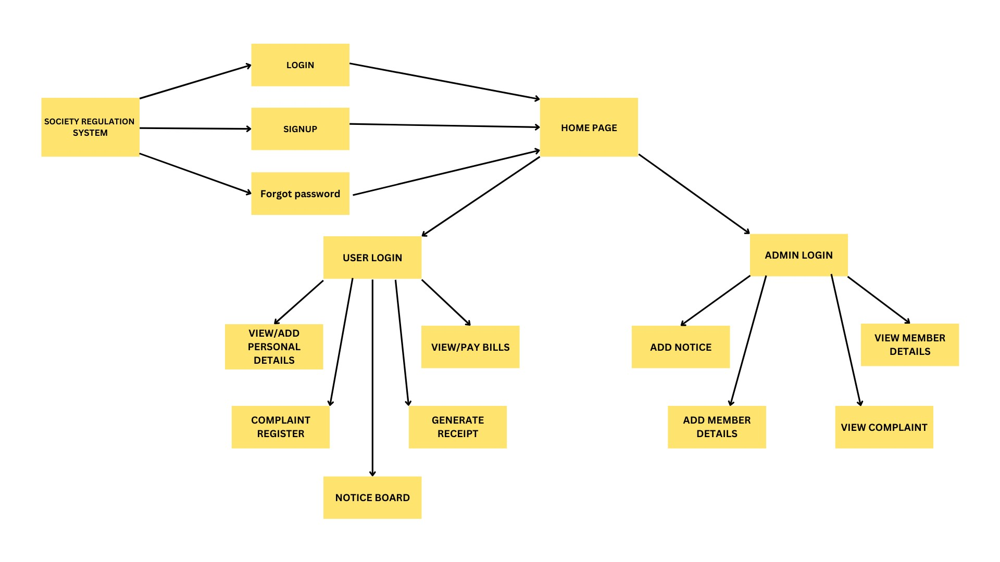
7. Block Diagram

Slide 9
Thank You...!!

